Slide 1
SMU NLP Course (DS7337) -- Homework 07 submission (07-29-2019)
Shanqing Gu (Class 401)
Outline of HW 07:
Q1. Clustering IMDB Movie Reviews
Text Preprocessing and Feature Engineering
Q1.1. K-Means Clustering Model
K-Means Clustering model with k= 4 (by main themes, and by pairwise document similarity)
K-Means Clustering model with k= 8 (by main themes, and by pairwise document similarity)
Plot K-Means Clustering results with k= 4 and 8 (by pairwise document similarity)
Q1.2. Hierarchical Clustering Model
Q2. What each cluster is generally centered on semantically?
Q2.1 - The KMeans algorithm
Q2.2 - The Hierarchical clustering algorithm
Q3. Compare clustering results with silhouette scores
Q3.1 - Silhouette Coefficient from KMeans Models
Q3.2 - Silhouette Coefficient from Hierarchical Clustering Models
Q3.3 - Compare Silhouette Coefficient in Clustering Models

Slide 2
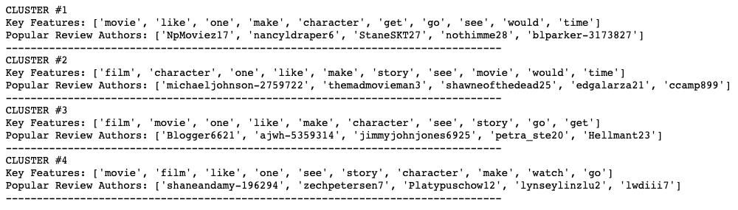
Question 1. Clustering IMDB Movie Reviews
Q1.1 Clustering IMDB Movie Reviews with K-Means Clustering Model
Text Preprocessing and Feature Engineering
Use the preprocessed movie reviews from homework 05.
Extract bag of words count based features for unigrams and bigrams (min_df =10 and max_df =0.8).
There are 956 movie reviews and 1561 features.
K-Means Clustering Model with k=4 (by main themes, 10 features with review author examples)

Slide 3
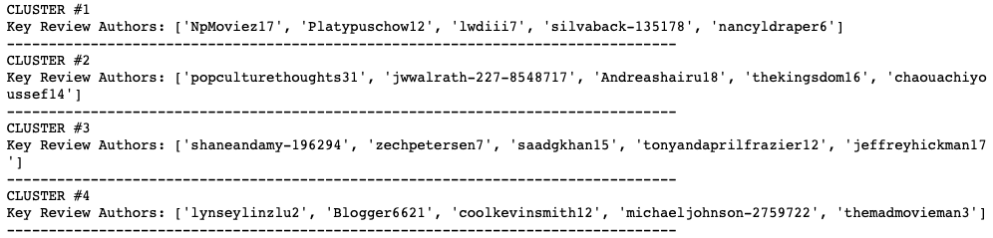
Question 1. Clustering IMDB Movie Reviews
Q1.1 Clustering IMDB Movie Reviews with K-Means Clustering Model
K-Means Clustering Model with k=4 (by pairwise document similarity, with review author examples)

Slide 4
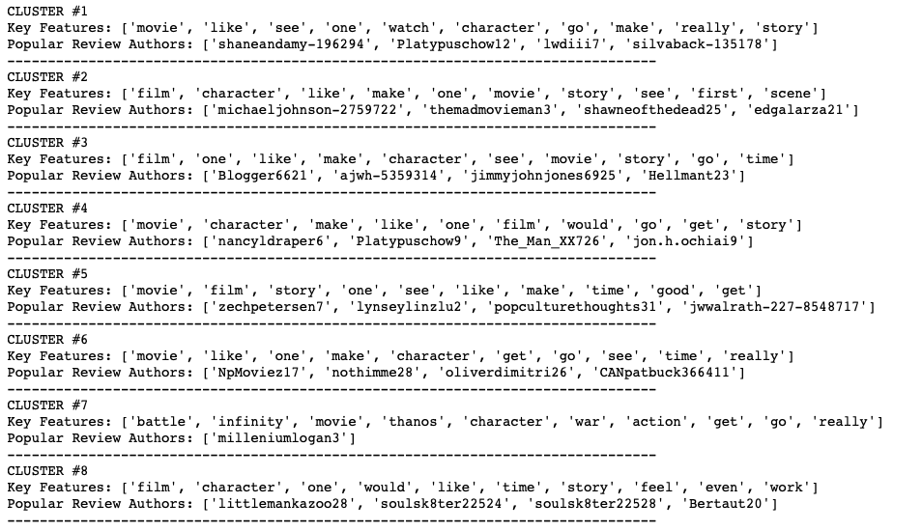
Question 1. Clustering IMDB Movie Reviews
Q1.1 Clustering IMDB Movie Reviews with K-Means Clustering Model
K-Means Clustering Model with k=8 (by main themes, 10 features with review author examples)

Slide 5
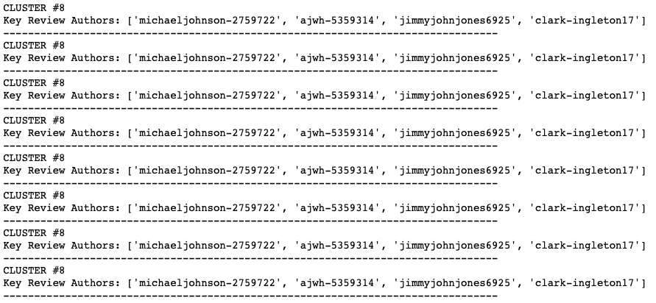
Question 1. Clustering IMDB Movie Reviews
Q1.1 Clustering IMDB Movie Reviews with K-Means Clustering Model
K-Means Clustering Model with k=8 (by pairwise document similarity, with review author examples)

Slide 6
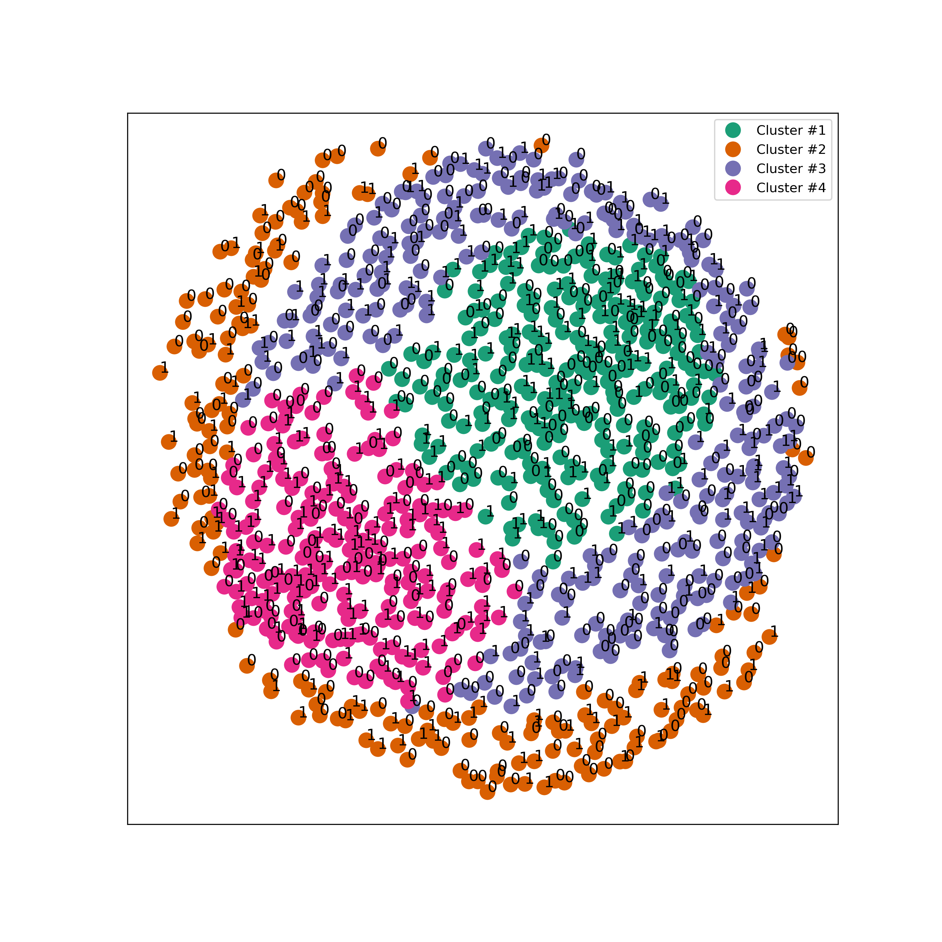
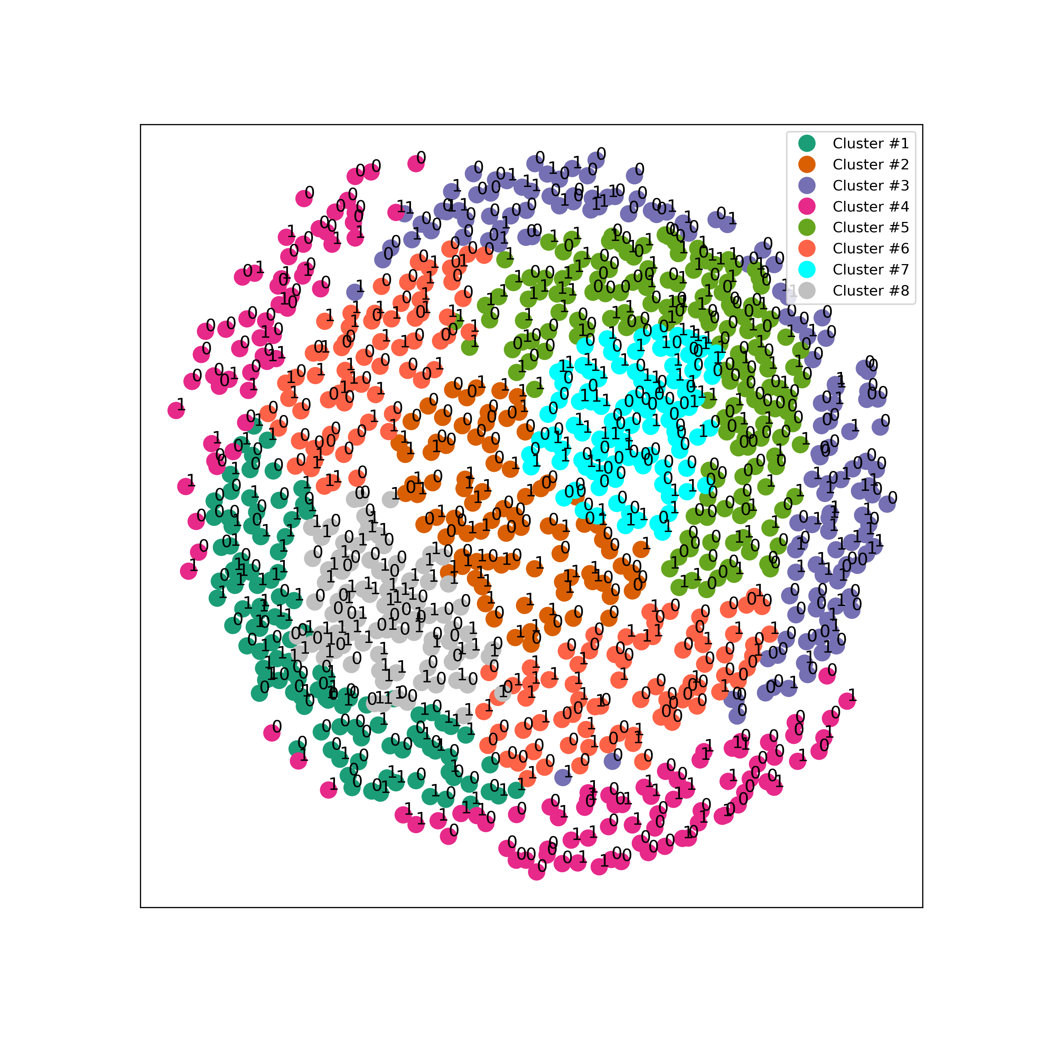
Question 1. Clustering IMDB Movie Reviews
Q1.1 Clustering IMDB Movie Reviews with K-Means Clustering Model
Plot K-Means Clustering results with k= 4 and 8 (by pairwise document similarity)
K = 4 K = 8
The movie reviews are scaled to 1 for positive ( more than 7/10), and to 0 as negative for others.

Slide 7
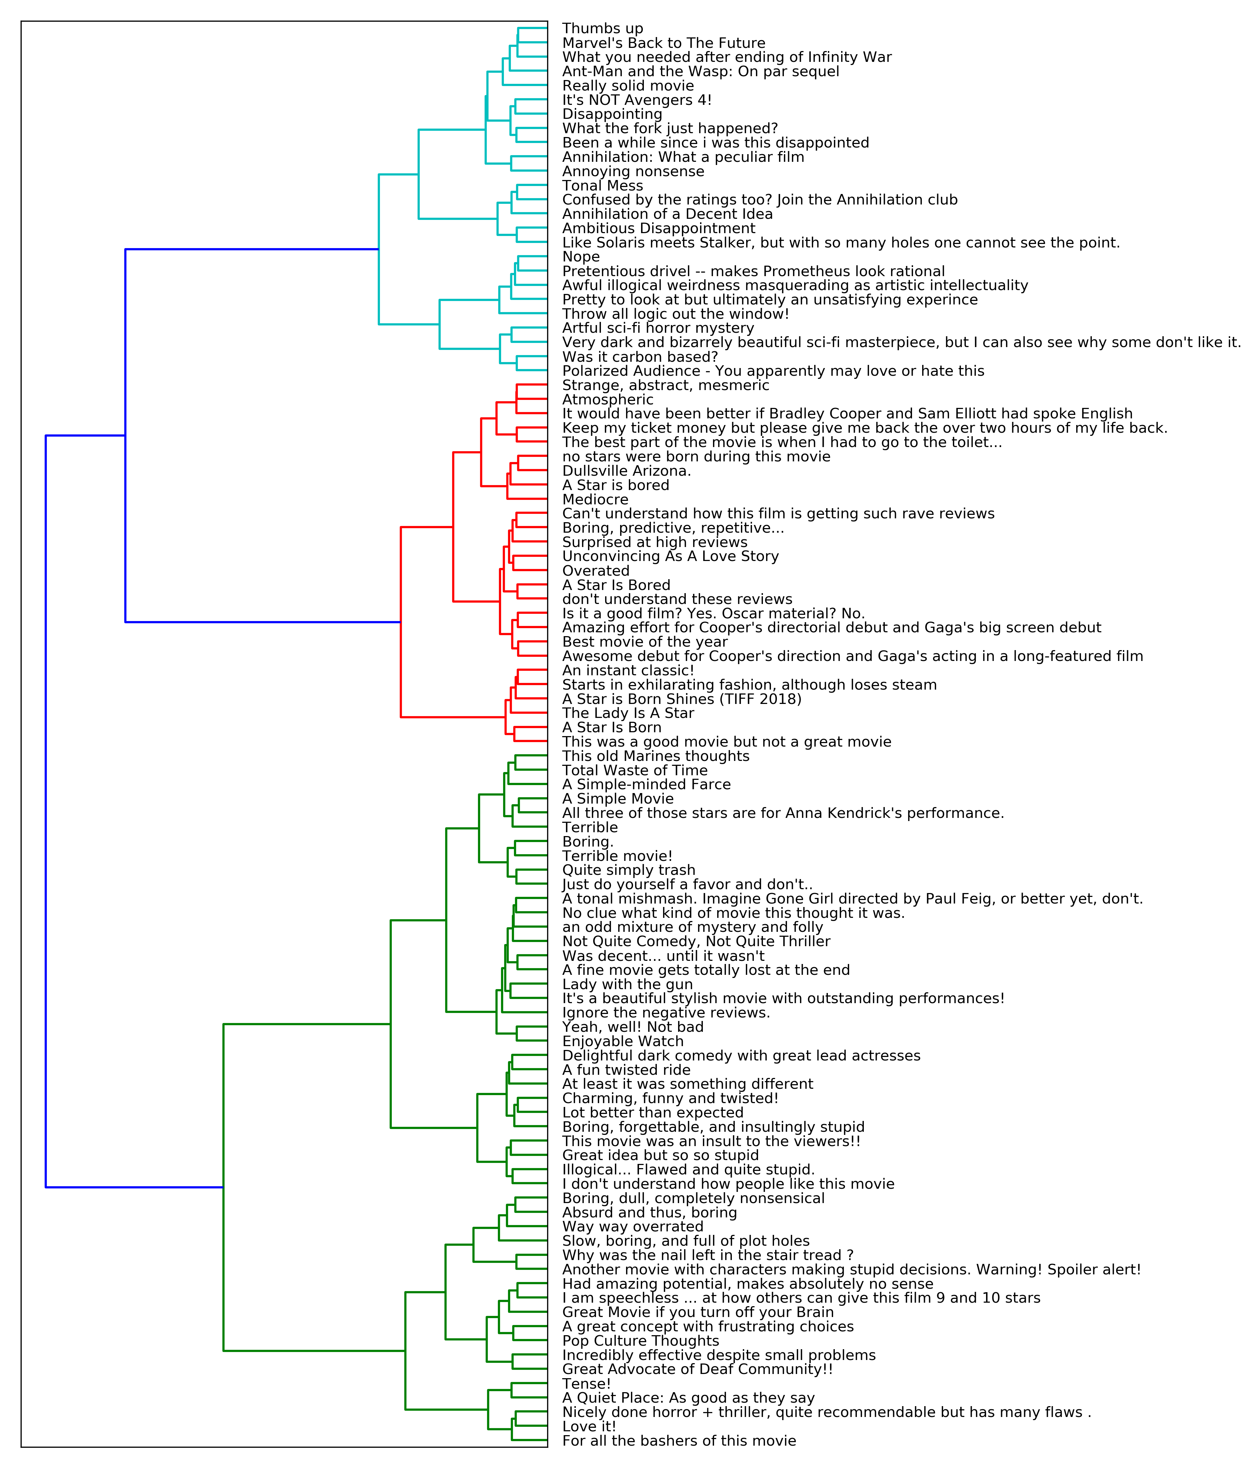
Question 1. Clustering IMDB Movie Reviews
Q1.2 Clustering IMDB Movie Reviews with Hierarchical Clustering Model (shown by review title)

Slide 8
Question 2. What each cluster is generally centered on semantically
KMeans clustering algorithm clusters data by trying to separate samples in n groups of equal variances, minimizing a criterion known as the inertia (within-cluster sum-of-squares) which can be recognized as a measure of how internally coherent clusters are. This algorithm requires the number of clusters to be specified. The Silhouette coefficient is calculated using the mean intra-cluster distance and the mean nearest-cluster distance for each sample. The best value is 1 and the worst value is -1.
The KMeans clustering algorithm (k = 4) performs better (silhouette coefficient = 0.19).
Hierarchical clustering algorithm, as depicted by a tree or dendrogram, can be divided into agglomerative ("from the bottom up") and divisive clustering ("from the top down"). There are four linkages (complete, average, ward and single) linkage for hierarchical agglomerative clustering with the basic idea to repeatedly merge two most similar groups as measured by the linkage. Ward linkage measures how much the sum of squares will increase when we merge two clusters, and single linkage measures the closest pair of points.
The hierarchical clustering algorithm (linkage 'ward', and n_clusters = 4) performs better (silhouette coefficient = 0.45).

Slide 9
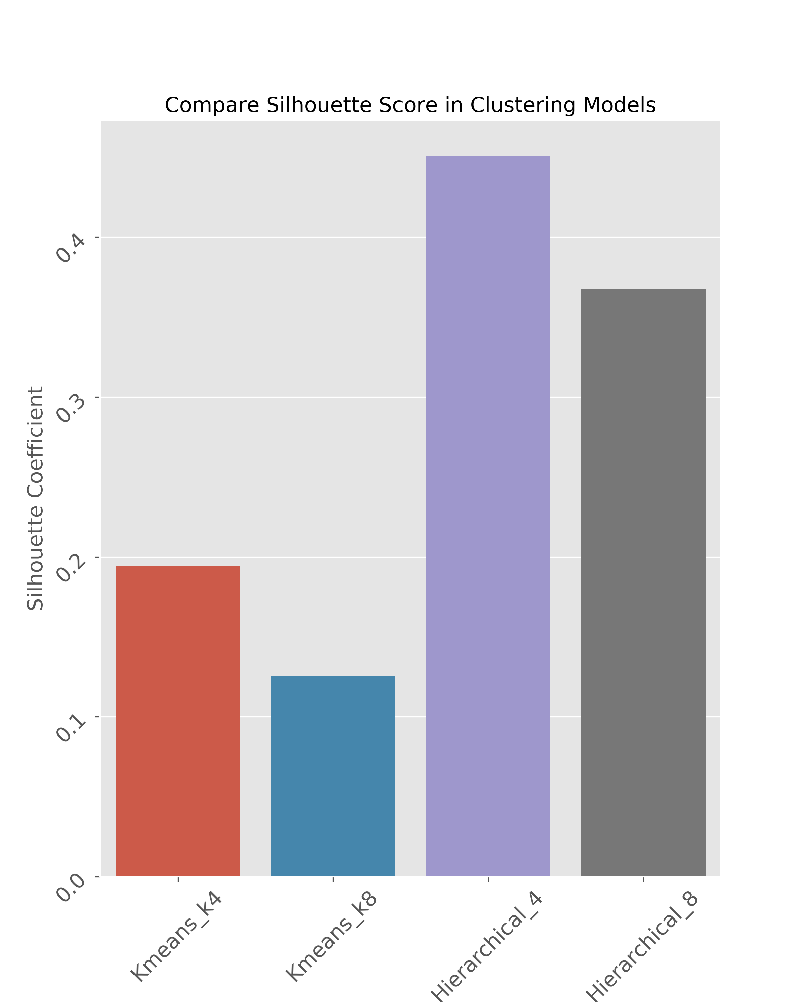
Question 3. Compare clustering results with silhouette scores
The silhouette coefficient is a measure of how similar an object is to its own cluster compared to other clusters.
The silhouette coefficient ranges from −1 to +1, where a high value indicates that the object is well matched to its own cluster and poorly matched to neighboring clusters.
The silhouette coefficients can be calculated with any distance metric.
From the silhouette coefficient results in 4 clustering models, the hierarchical clustering algorithm (linkage 'ward', and n_clusters = 4) performs best (silhouette coefficient = 0.45).

Slide 10
References
1. Sarkar D. Text analytics with Python, 2nd edition
2. Document Clustering with Python (http://brandonrose.org/clustering)
Implementation environments
Darwin-18.6.0-x86_64-i386-64bit
Python 3.6.8 |Anaconda, Inc.| (default, Dec 29 2018, 19:04:46) [GCC 4.2.1 Compatible Clang 4.0.1 (tags/RELEASE_401/final)] Pandas 0.24.2
NumPy 1.16.4
Requests 2.22.0
Pickle 4.0 Re 2.2.1
nltk 3.4
Matplotlib 3.0.2
Sklearn 0.21.2
Scipy 1.2.1

